Slide 1
Parallel and Perpendicular Lines
Geometry
Chapter 3
Notes:
Geometry 3

Slide 2
This Slideshow was developed to accompany the textbook
Larson Geometry
By Larson, R., Boswell, L., Kanold, T. D., & Stiff, L.
2011 Holt McDougal
Some examples and diagrams are taken from the textbook.
Slides created by
Richard Wright, Andrews Academy
rwright@andrews.edu

Slide 3
3.1 Identify Pairs of Lines and Angles
Parallel Lines ||
Lines that do NOT intersect and are coplanar
Lines go in the same direction
Skew Lines
Lines that do NOT intersect and are on different planes
Lines go in different directions

Slide 4
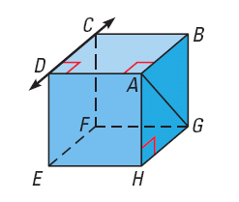
3.1 Identify Pairs of Lines and Angles
Name the lines through point H that appear skew to $\overset{⃡}{CD}$
Name the lines containing point H that appear parallel to $\overset{⃡}{CD}$
Name a plane that is parallel to plane CDE and contains point H
Notes:
AH, EH
GH
BGH

Slide 5
3.1 Identify Pairs of Lines and Angles
In a plane, two lines are either
Parallel
Intersect
Parallel Postulate
If there is a line and a point not on the line, then there is exactly one line through the point parallel to the given line.
Perpendicular Postulate
If there is a line and a point not on the line, then there is exactly one line through the point perpendicular to the given line.

Slide 6
3.1 Identify Pairs of Lines and Angles
Transversal
Line that intersects two coplanar lines
Interior ∠
angles that are between the lines
1
∠2, ∠3, ∠5, ∠6
4
2
3
Exterior ∠
5
6
angles that are outside of the lines
8
7
∠1, ∠4, ∠7, ∠8

Slide 7
3.1 Identify Pairs of Lines and Angles
Alternate interior angles
interior angles on opposite sides of the transversal
∠2 and ∠5, ∠3 and ∠6
1
4
2
Alternate exterior angles
3
exterior angles on opposite sides of the transversal
5
6
∠1 and ∠8, ∠4 and ∠7
8
7

Slide 8
3.1 Identify Pairs of Lines and Angles
Consecutive interior angles
interior angles on the same side of the transversal
∠2 and ∠6, ∠3 and ∠5
1
4
2
Corresponding angles
3
angles on the same location relative to the transversal
5
6
∠1 and ∠6, ∠2 and ∠7,
∠3 and ∠8, ∠4 and ∠5
8
7

Slide 9
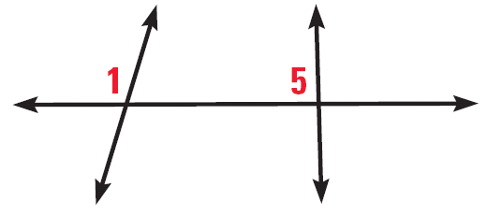
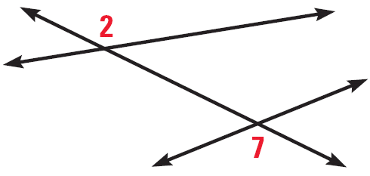
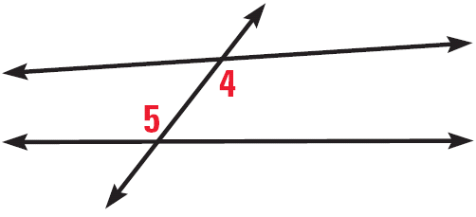
3.1 Identify Pairs of Lines and Angles
Classify the pair of numbered angles
150 #4-42 even, 45-49 all = 25 total
Notes:
Corresponding
Alternate Exterior
Alternate Interior

Slide 10
Answers and Quiz
3.1 Answers
3.1 Quiz

Slide 11
3.2 Use Parallel Lines and Transversals
Draw parallel lines on a piece of notebook paper, then draw a transversal.
Use the protractor to measure all the angles.
What types of angles are congruent?
(corresponding, alt interior, alt exterior)
How are consecutive interior angles related?
(supplementary)

Slide 12
3.2 Use Parallel Lines and Transversals
Corresponding Angles Postulate
If 2 || lines are cut by trans., then the corrs ∠ are ≅
Alternate Interior Angles Theorem
If 2 || lines are cut by trans., then the alt int ∠ are ≅
Alternate Exterior Angles Theorem
If 2 || lines are cut by trans., then the alt ext ∠ are ≅
Consecutive Interior Angles Theorem
If 2 || lines are cut by trans., then the cons int ∠ are supp.

Slide 13
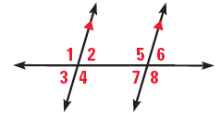
3.2 Use Parallel Lines and Transversals
If m∠1 = 105°, find m∠4, m∠5, and m∠8. Tell which postulate or theorem you use in each case
If m∠3 = 68° and m∠8 = (2x + 4)°, what is the value of x?
Notes:
m∠4 = 105; vertical angles are congruent
m∠5 = 105; corresponding angles postulate
m∠8 = 105; alt ext angles theorem
m∠3 = m∠2
m∠8 = m∠5
∠2 and ∠5 are cons int angles and are supp
m∠2 + m∠5 = 180
m∠3 + m∠8 = 180
68 + 2x + 4 = 180
2x + 72 = 180
2x = 108
x = 54

Slide 14
3.2 Use Parallel Lines and Transversals
Prove that if 2 || lines are cut by a trans, then the ext angles on the same side of the trans are supp.
Given: p || q
Prove: ∠1 and ∠2 are supp.
ℓ
1
q
3
p
2
Statements
Reasons
Notes:
p || q (given)
m∠1 + m∠3 = 180 (linear pair post)
∠2 ≅ ∠3 (corrs angles post)
m∠2 = m∠3 (def ≅)
m∠1 + m∠2 = 180 (substitution)
∠1 and ∠2 are supp (def supp)

Slide 15
3.2 Use Parallel Lines and Transversals
157 #2-32 even, 36-52 even = 25 total
Extra Credit 160 #2, 6 = +2

Slide 16
Answers and Quiz
3.2 Answers
3.2 Quiz

Slide 17
3.3 Prove Lines are Parallel
Corresponding Angles Converse
If 2 lines are cut by trans. so the corrs ∠ are ≅, then the lines are ||.
Alternate Interior Angles Converse
If 2 lines are cut by trans. so the alt int ∠ are ≅, then the lines are ||.
Alternate Exterior Angles Converse
If 2 lines are cut by trans. so the alt ext ∠ are ≅, then the lines are ||.
Consecutive Interior Angles Converse
If 2 lines are cut by trans. so the cons int ∠ are supp., then the lines are ||.

Slide 18
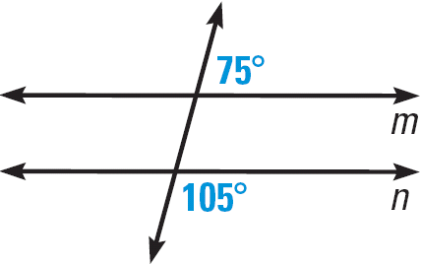
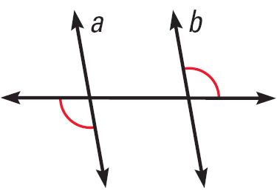
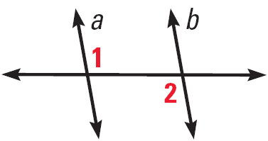
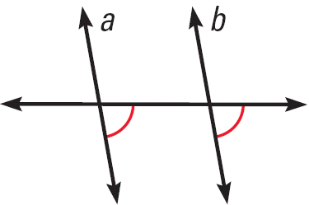
3.3 Prove Lines are Parallel
Is there enough information to conclude that m || n?
Can you prove that the lines are parallel? Explain.
m ∠1 + m ∠2 = 180°
Notes:
Yes, corresponding angles will both be 75°
Yes, alt ext angles converse
Yes, corres angles converse
No, should be ∠1 ≅ ∠2 by alt int angles converse

Slide 19
3.3 Prove Lines are Parallel
Transitive Property of Parallel Lines
If two lines are parallel to the same line, then they are parallel to each other.
Paragraph proofs
The proof is written in sentences.
Still need to have the statements and reasons.

Slide 20
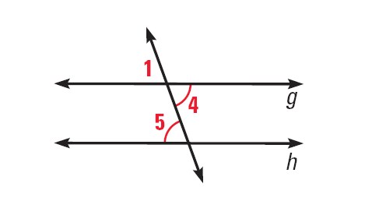
3.3 Prove Lines are Parallel
Write a paragraph proof to prove that if 2 lines are cut by a trans. so that the alt int ∠s are ≅, then the lines are ||.
Given: ∠4 ≅ ∠5
Prove: g || h
Notes:
It is given that ∠4 ≅ ∠5. By the vertical angle congruence theorem, ∠1 ≅ ∠4. Then by the Transitive Property of Congruence, ∠1 ≅ ∠5. So, by the Corresponding Angles Converse, g || h.

Slide 21
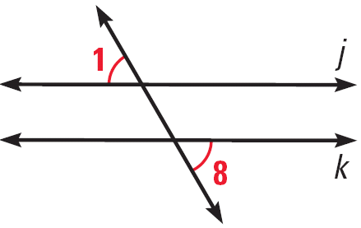
3.3 Prove Lines are Parallel
If you use the diagram at the right to prove the Alternate Exterior Angles Converse, what GIVEN and PROVE statements would you use?
165 #2-28 even, 34, 36, 40-54 even = 24 total
Notes:
Given: ∠1 ≅ ∠8
Prove: j || k

Slide 22
Answers and Quiz
3.3 Answers
3.3 Quiz

Slide 23
3.4 Find and Use Slope of Lines
$\text{Slope}=\frac{\text{rise}}{\text{run}}$
$m=\frac{y_{2}−y_{1}}{x_{2}−x_{1}}$
(x₂, y₂)
rise
(x₁, y₁)
run

Slide 24
3.4 Find and Use Slope of Lines
Positive Slope
Rises
Zero Slope
Horizontal
Negative Slope
Falls
No Slope (Undefined)
Vertical
0
+
–
No
There’s No Slope to stand on.

Slide 25
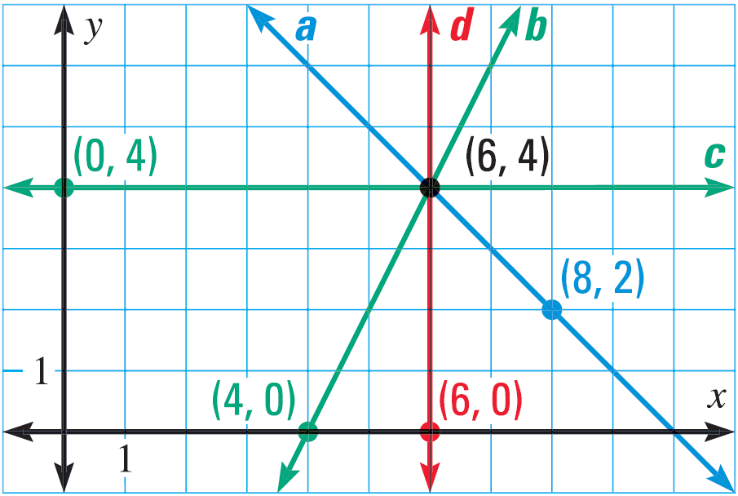
3.4 Find and Use Slope of Lines
Find the slope of
Line b
Line c
Notes:
Line b: m = (4 – 0)/(6 – 4) = 4/2 = 2
Line c: m = (4 – 4)/(6 – 0) = 0 / 6 = 0

Slide 26
3.4 Find and Use Slope of Lines
Slopes of Parallel Lines
In a coordinate plane, 2 nonvertical lines are parallel iff they have the same slope.
And, any 2 vertical lines are parallel.
m₁ = 2; m₂ = 2
Slopes of Perpendicular Lines
In a coordinate plane, 2 nonvertical lines are perpendicular iff the products of their slopes is -1.
Or, Slopes are negative reciprocals.
And, horizontal lines are perpendicular to vertical lines
m₁ = 2; m₂ = -½

Slide 27
3.4 Find and Use Slope of Lines
Tell whether the lines are parallel, perpendicular, or neither.
Line 1: through (–2, 8) and (2, –4)
Line 2: through (–5, 1) and (–2, 2)
Line 1: through (–4, –2) and (1, 7)
Line 2: through (–1, –4) and (3, 5)
Notes:
Line 1: (-4 – 8)/(2 – (-2)) → -12/4 → -3
Line 2: (2 – 1)/(-2 – (-5)) → 1/3
Perpendicular
Line 1: (7 – (-2))/(1 – (-4)) → 9/5
Line 2: (5 – (-4))/(3 – (-1)) → 9/4
neither

Slide 28
3.4 Find and Use Slope of Lines
Line q passes through the points (0, 0) and (-4, 5). Line t passes through the points (0, 0) and (-10, 7). Which line is steeper, q or t?
175 #4-30 even, 34, 36, 40, 44, 46, 48 = 20 total
Extra Credit 178 #2, 4 = +2
Notes:
m_{q} = (5 – 0)/(-4 – 0) = 5/-4 = -5/4 = -1.25
m_{t} = (7 – 0)/(-10 – 0) = 7/-10 = -7/10 = -0.7
Line q is steeper

Slide 29
Answers and Quiz
3.4 Answers
3.4 Quiz

Slide 30
3.5 Write and Graph Equations of Lines
Slope-intercept form of a line
y = mx + b
m = slope
b = y-intercept
To graph in slope intercept form
Plot the y-intercept
Move from the y-int the slope to find a couple more points
Connect the points with a line

Slide 31
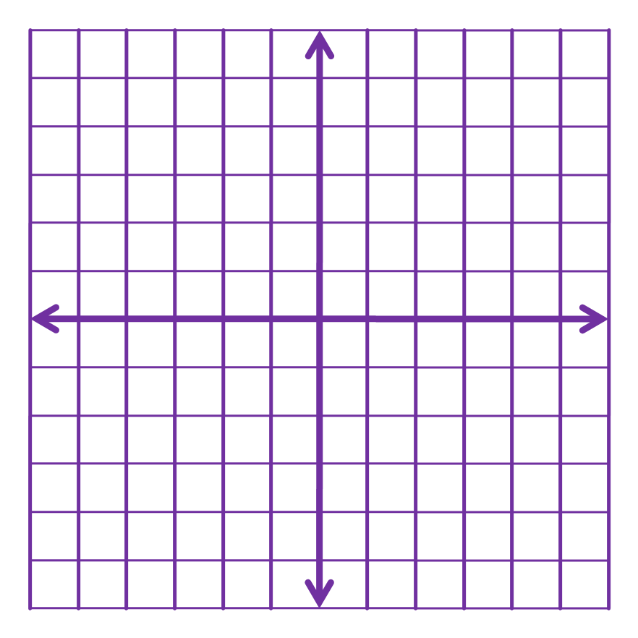
3.5 Write and Graph Equations of Lines
Graph
y = -2x
y = x – 3

Slide 32
3.5 Write and Graph Equations of Lines
To write equations of lines using slope-intercept form
Find the slope
Find the y-intercept
It is given or,
Plug the slope and a point into y = mx + b and solve for b
Write the equation of the line by plugging in m and b into y = mx + b

Slide 33
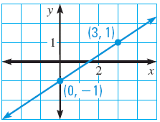
3.5 Write and Graph Equations of Lines
Write an equation of the line in the graph

Slide 34
3.5 Write and Graph Equations of Lines
Write an equation of the line that passes through (-2, 5) and (1, 2)

Slide 35
3.5 Write and Graph Equations of Lines
Write an equation of the line that passes through (1, 5) and is parallel to the line with the equation y = 3x – 5.

Slide 36
3.5 Write and Graph Equations of Lines
Standard Form
Ax + By = C
A, B, and C are integers
To graph
Find the x- and y-intercepts by letting the other variable = 0
Plot the two points
Draw a line through the two points
x-intercept:
Ax + B(0) = C
Ax = C
x = C/A
Y-intercept:
A(0) + By = C
By = C
y = C/B

Slide 37
3.5 Write and Graph Equations of Lines
Graph
2x + 5y = 10
184 #2-12 even, 16-26 even, 30-36 even, 40, 44, 46, 60, 62, 68-74 even = 25 total

Slide 38
Answers and Quiz
3.5 Answers
3.5 Quiz

Slide 39
3.6 Prove Theorems About Perpendicular Lines
If two lines intersect to form a linear pair of congruent angles, then the lines are perpendicular.
If two lines are perpendicular, then they intersect to form four right angles.
If two sides of two adjacent angles are perpendicular, then the angles are complementary.

Slide 40
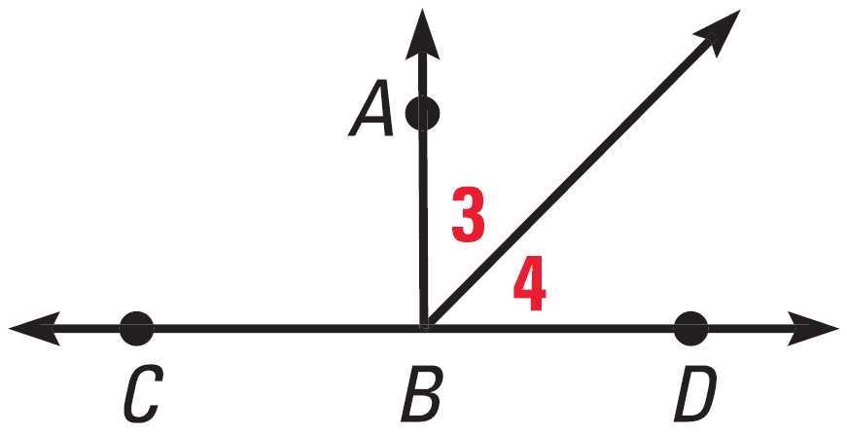
3.6 Prove Theorems About Perpendicular Lines
Given that ∠ABC ≅ ∠ABD, what can you conclude about ∠3 and ∠4?

Slide 41
3.6 Prove Theorems About Perpendicular Lines
Prove that if two lines are perpendicular, then they intersect to form four right angles.
Given: a ⊥ b
Prove: ∠1, ∠2, ∠3, ∠4 are rt ∠s.
a
4
1
b
3
2
Statements
Reasons
Notes:
a ⊥ b (given)
∠1 is rt angle (def ⊥ lines)
m∠1 = 90° (def rt angle)
m∠1 + m∠2 = 180 (linear pair postulate)
90 + m∠2 = 180 (substitution)
m∠2 = 90 (subtraction)
∠2 is rt angle (def rt angle)
∠3 ≅ ∠1, ∠4 ≅ ∠2 (vertical angles are ≅)
m∠3 = m∠1, m∠4 = m∠2 (def ≅)
m∠3 = 90, m∠4 = 90 (substitution)
∠3 is rt ∠, ∠4 is rt ∠ (def rt ∠)

Slide 42
3.6 Prove Theorems About Perpendicular Lines
Perpendicular Transversal Theorem
If a trans. is ⊥ to 1 of 2 || lines, then it is ⊥ to the other.
Lines ⊥ to a Transversal Theorem
In a plane, if 2 lines are ⊥ to the same line, then they are || to each other.

Slide 43
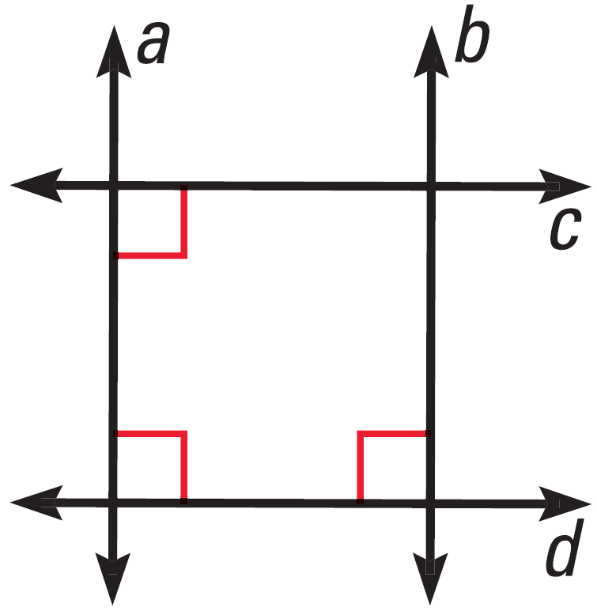
3.6 Prove Theorems About Perpendicular Lines
Is b || a?
Is b ⊥ c?
Notes:
Yes, lines perpendicular to transversal theorem
Yes, c || d by the lines ⊥ to trans theorem; b ⊥ c by the ⊥ trans theorem

Slide 44
3.6 Prove Theorems About Perpendicular Lines
Distance
From point to line: length of segment from point and ⊥ to line
Between two || lines: length of segment ⊥ to both lines

Slide 45
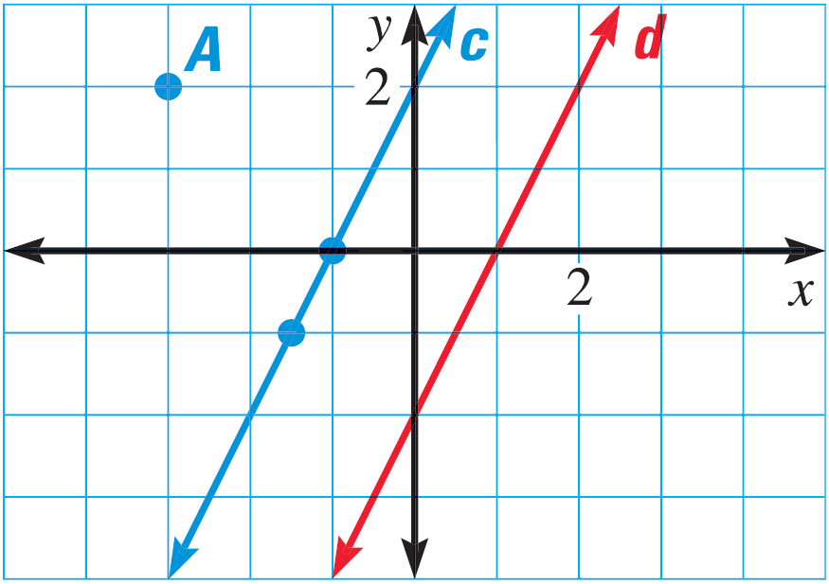
3.6 Prove Theorems About Perpendicular Lines
What is the distance from point A to line d?
What is the distance from line c to line e?
e
Notes:
Slope of line c = 2 (rise = 2, run = 1)
Slope of ⊥ line = -1/2
Follow slope from A(-3, 2) to line cd; intersection at (1, 0)
Calculate distance $\sqrt{{\left(1−\left(−3\right)\right)}^{2}+{\left(0−2\right)}^{2}}=\sqrt{4^{2}+{\left(−2\right)}^{2}}=\sqrt{20}=2\sqrt{5}=4.47$
Point on line c: (0, 2)
Follow slope from (0, 2) to line e
Point of intersection (4, 0)
Distance = $\sqrt{{\left(4−0\right)}^{2}+{\left(0−2\right)}^{2}}=\sqrt{16+4}=\sqrt{20}=2\sqrt{5}=4.47$

Slide 46
3.6 Prove Theorems About Perpendicular Lines
194 #2-10 even, 14-26 even, 30-46 even = 21 total
Extra Credit 197 #2, 8 = +2

Slide 47
Answers and Quiz
3.6 Answers
3.6 Quiz

Slide 48
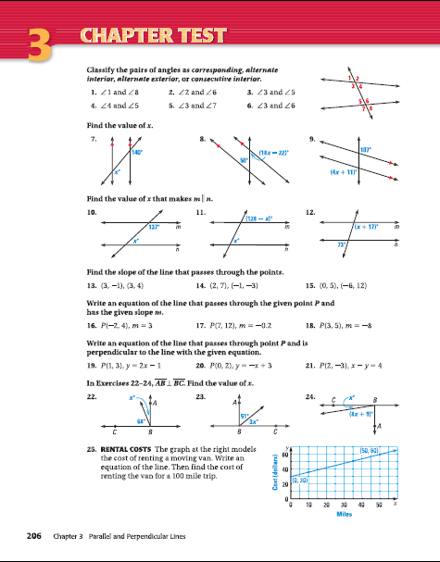
3.Review
206 #1-25 = 25 total

